Slide 1
United states house rent prediction
Info 6105 Sec 34274
Group 19
Ashish Roy - 001044804
Vaishnavi Gadve - 001568298

Slide 2
OVERVIEW
5. Modeling and PROCESSING
4. Data Encoding
3. EDA
2. Handling missing values and outliers
1. Data description

Slide 3
Motivation
To help Landlords, Tenants and Investors accurately price rental apartment to create a transparent and easy to navigate rental market, and thereby improving the efficiency of their investment returns.

Slide 4
Goals
1.
2.
3.
A model to estimate fair rent of an apartment
Minimize the error between actual rent and rent estimators
Evaluate performance of multiple model and select the best

Slide 5
Description of Dataset
The dataset consists of all types of rental houses in 39 states web scaped from craigslist. We took the dataset from iNeuron’s ML Challenge 2.
Dataset size: 380.3MB
Number of columns: 22
Number of rows: 265,190

Slide 6
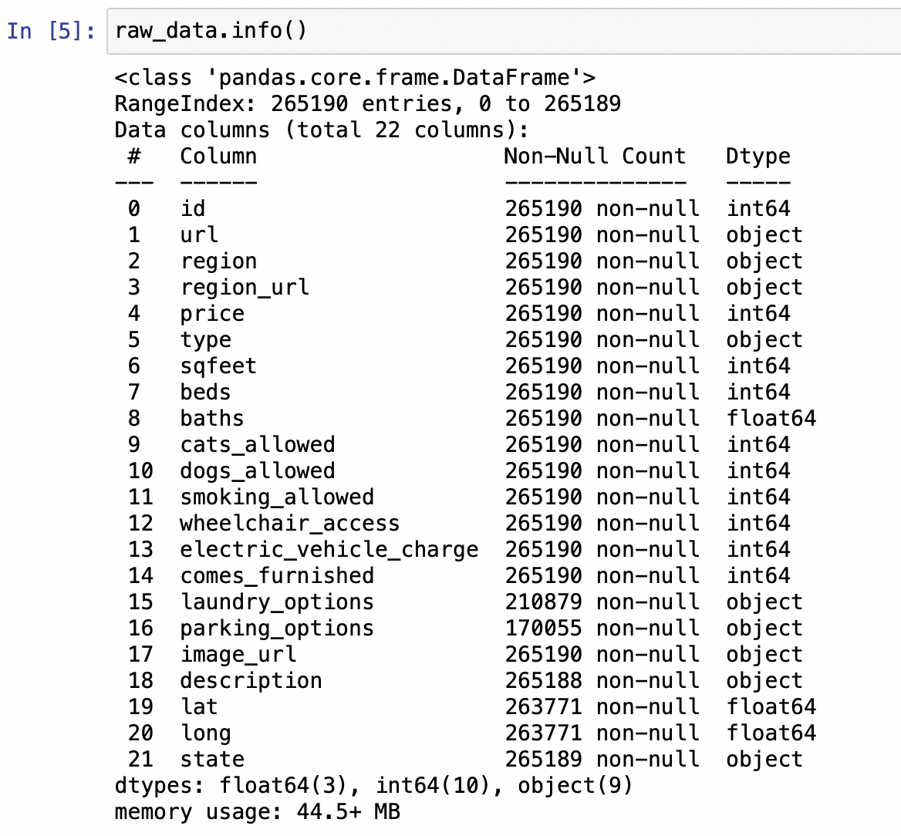
Description of Columns

Slide 7
Description of Columns
id: Craigslist ID of each listing
url: URL of each listing
region_url: URL for services and amenities for each listing
image_url: URL of image of each listing
description: Description by previous tenants

Slide 8
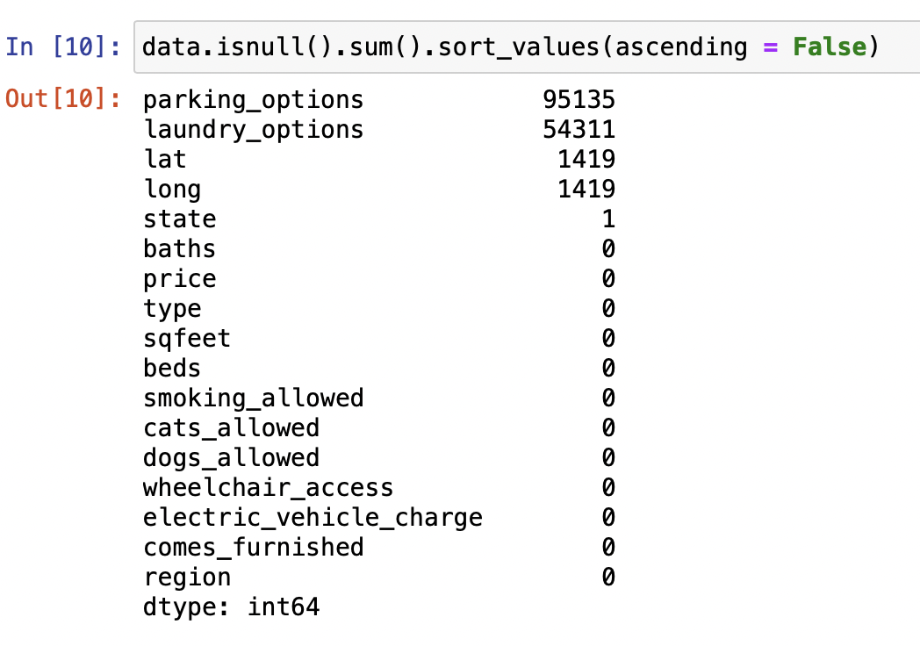

Missing Values

Slide 9
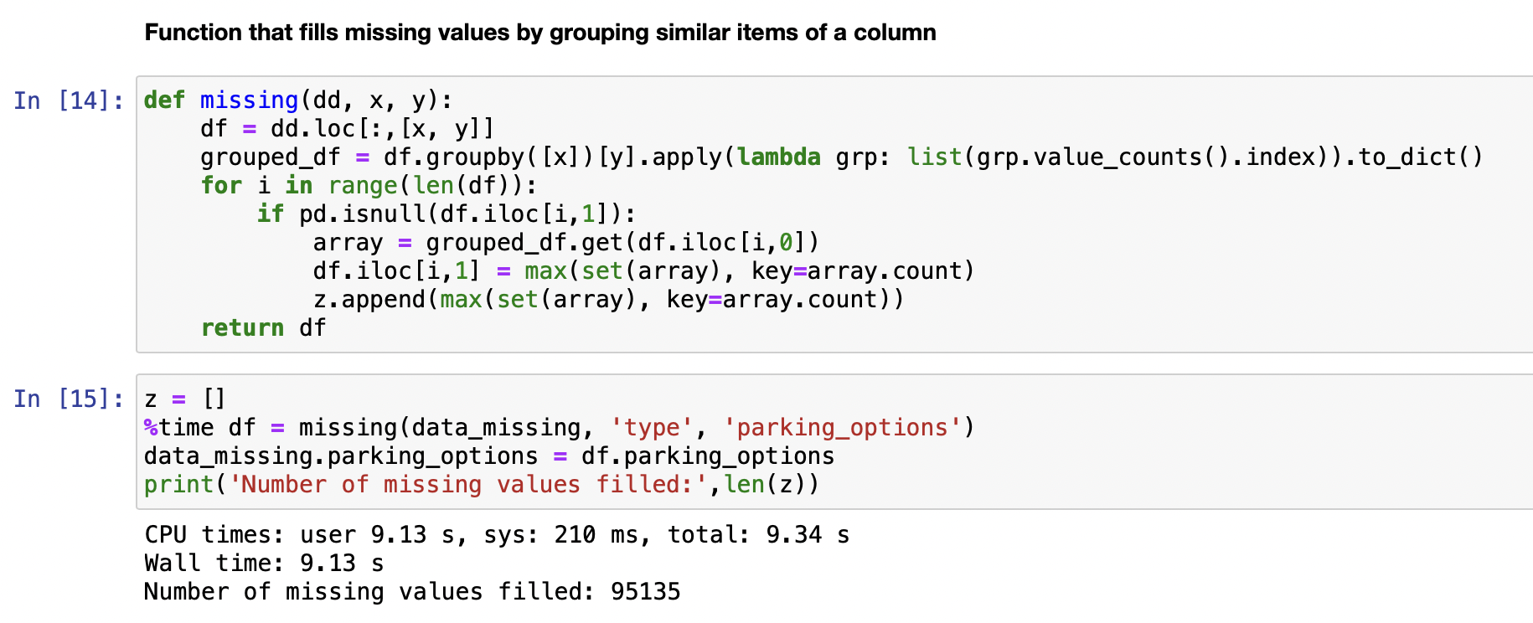
Missing Values

Slide 10
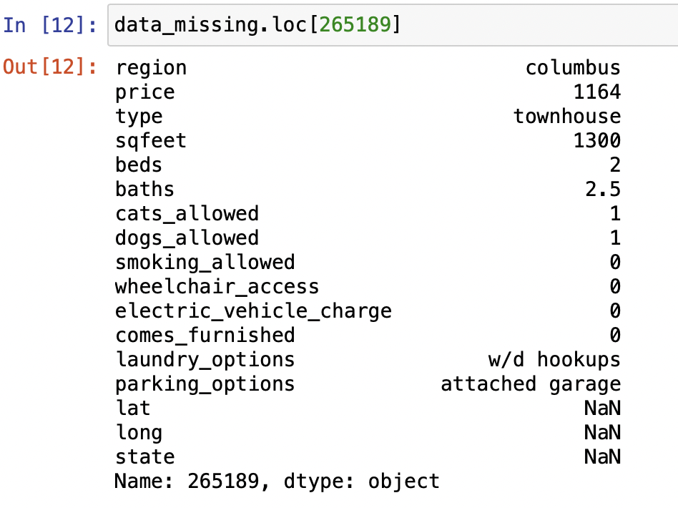
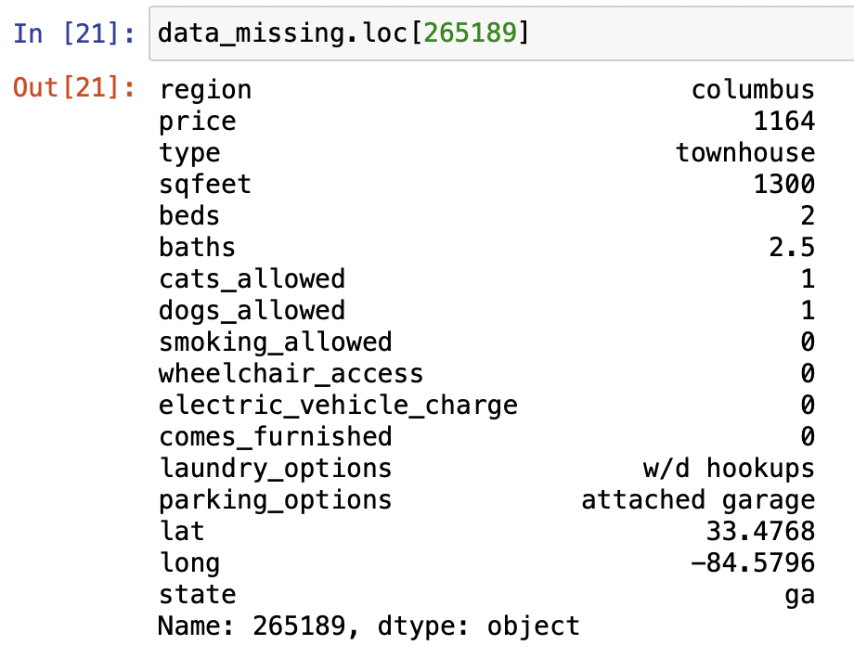
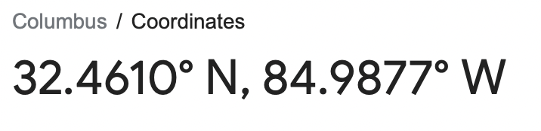
Missing Values

Slide 11
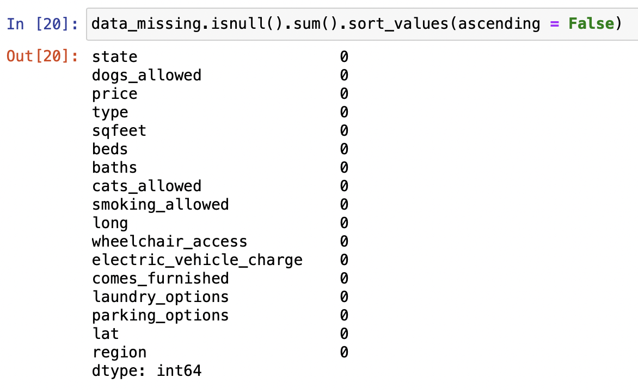
Missing Values

Slide 12
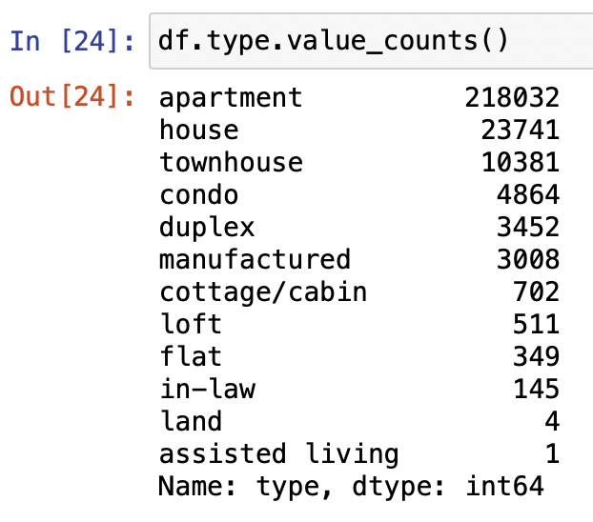
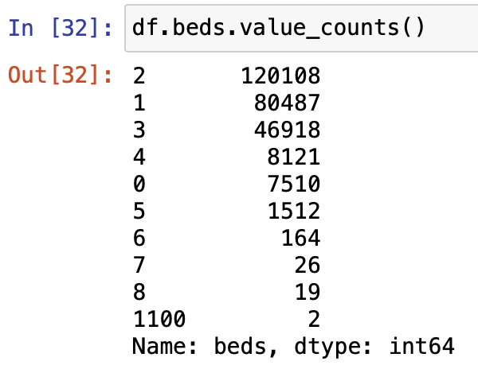
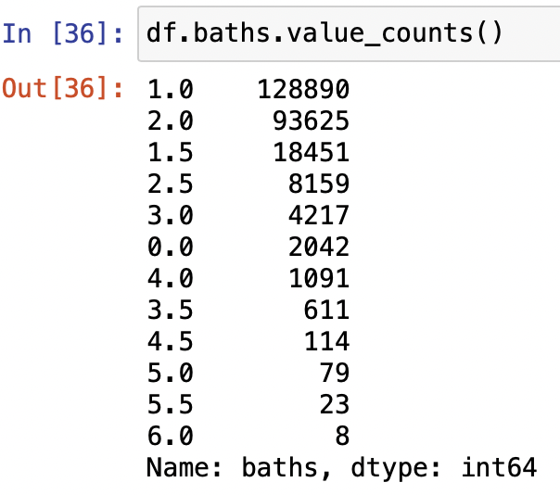

Dealing with Outliers
Type
Beds
Baths

Slide 13
Dealing with Outliers
Nationally, 91 percent of new homes built in 2018 were less than 4,000 square feet, with a median size of 2,386 square feet, according to the Census Bureau’s Survey of Construction. Restricting square feet in out data to 4000 square feet.
Checking the houses >4000sqft and removing them

Slide 14
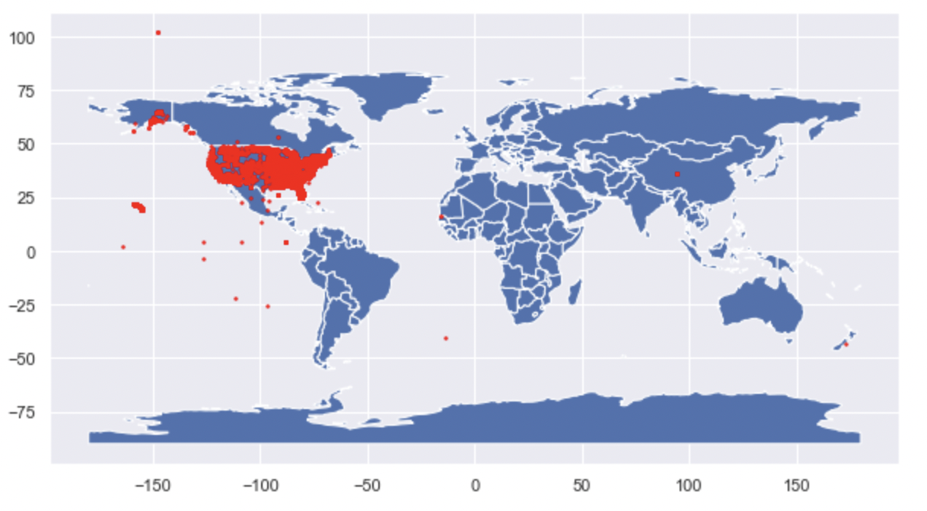
Dealing with Outliers
Lat & long

Slide 15
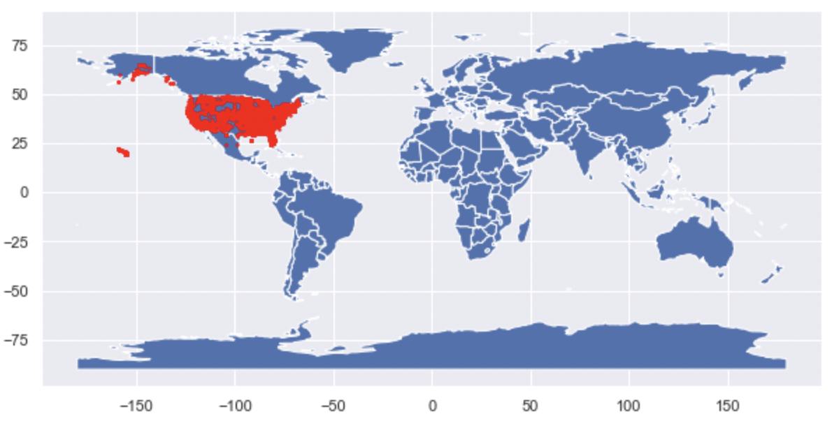
Dealing with Outliers
Lat & long

Slide 16
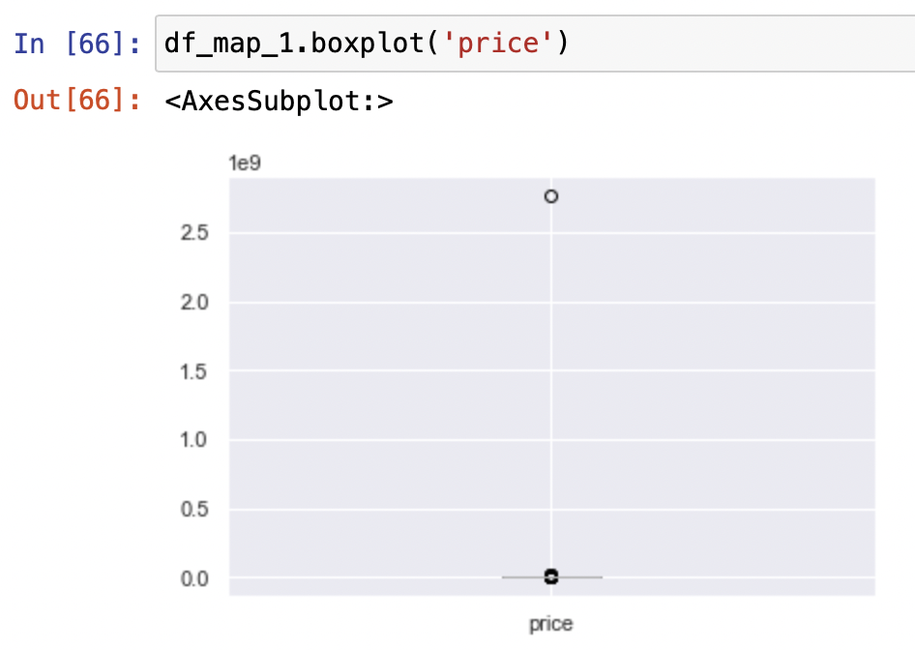
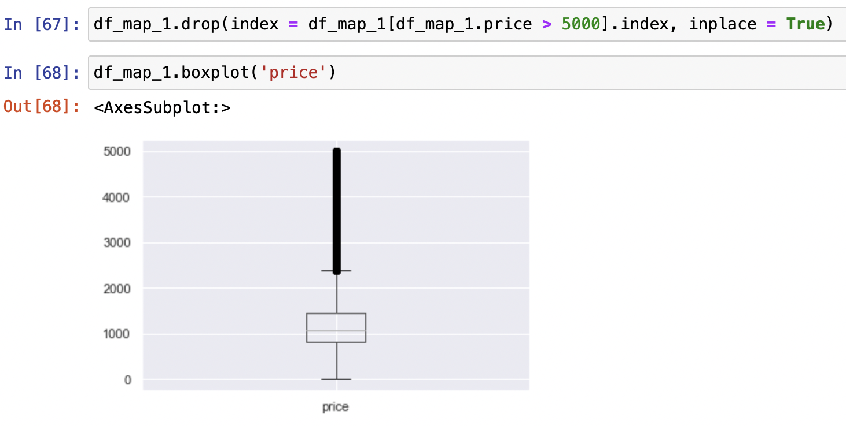
Dealing with Outliers
price

Slide 17
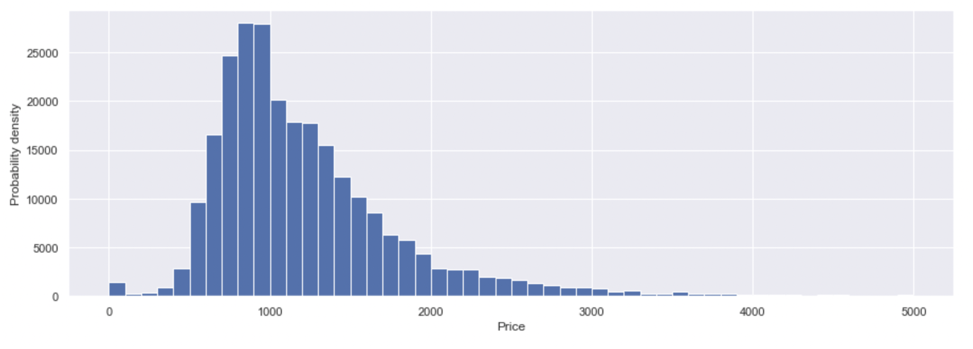


Data Visualization
price

Slide 18
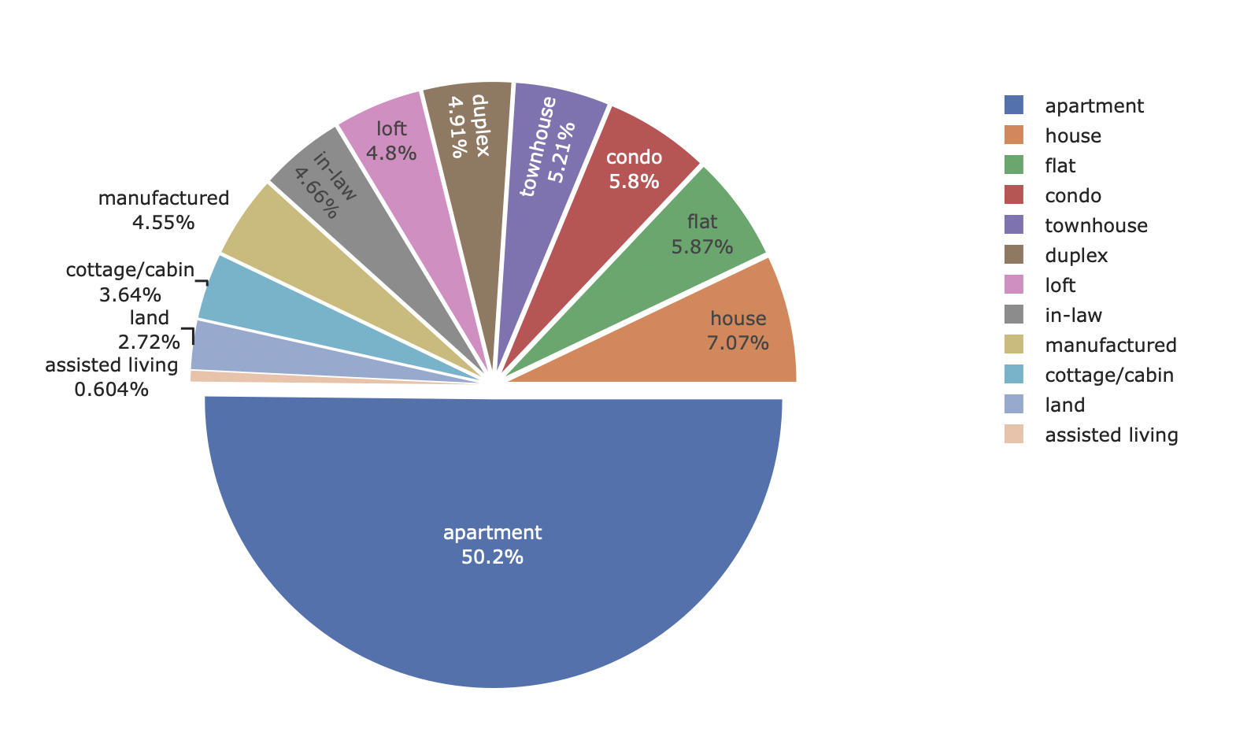
Data Visualization
Type

Slide 19
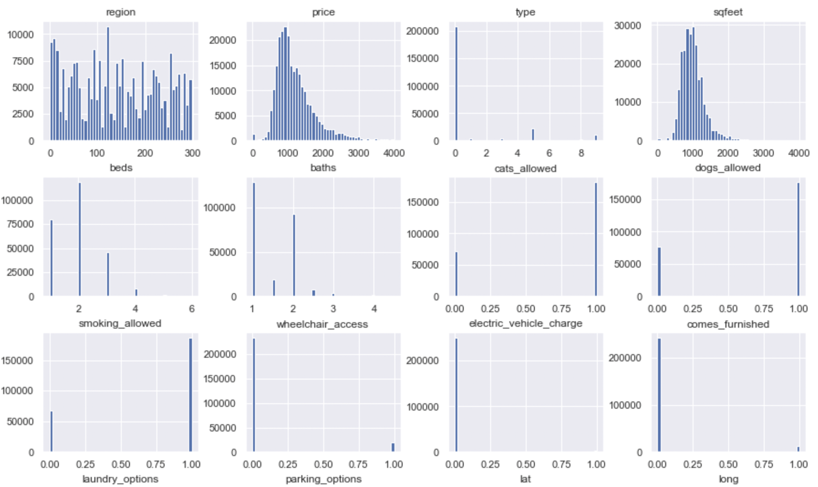
Data Visualization

Slide 20
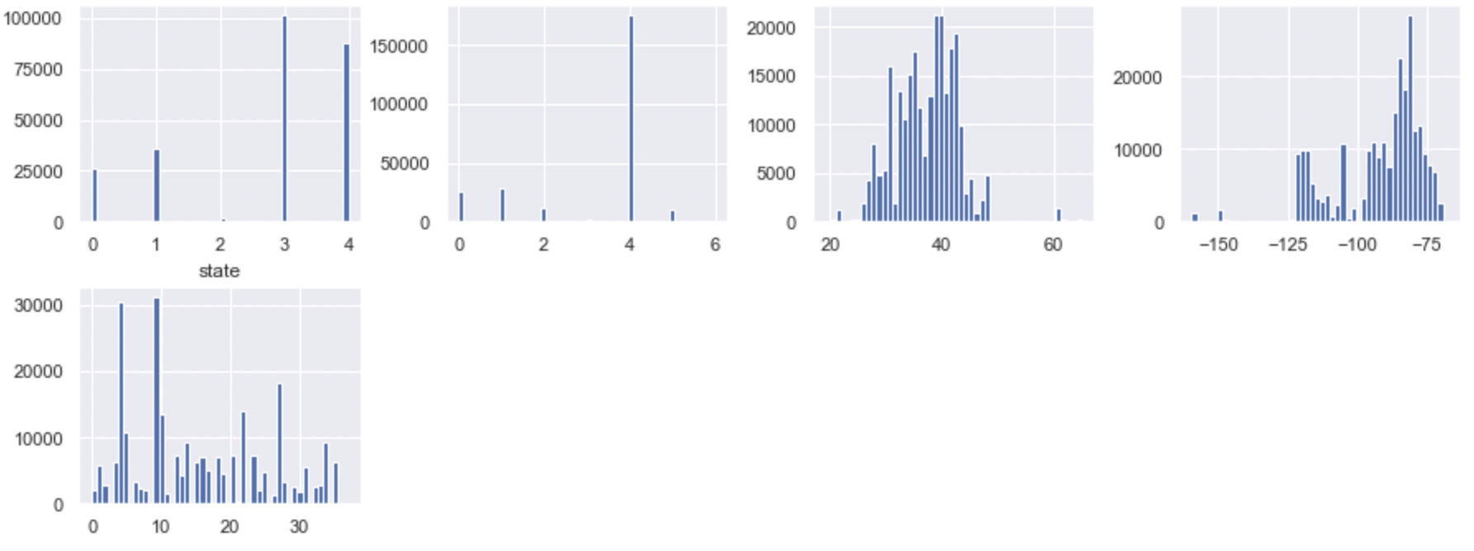
Data Visualization

Slide 21
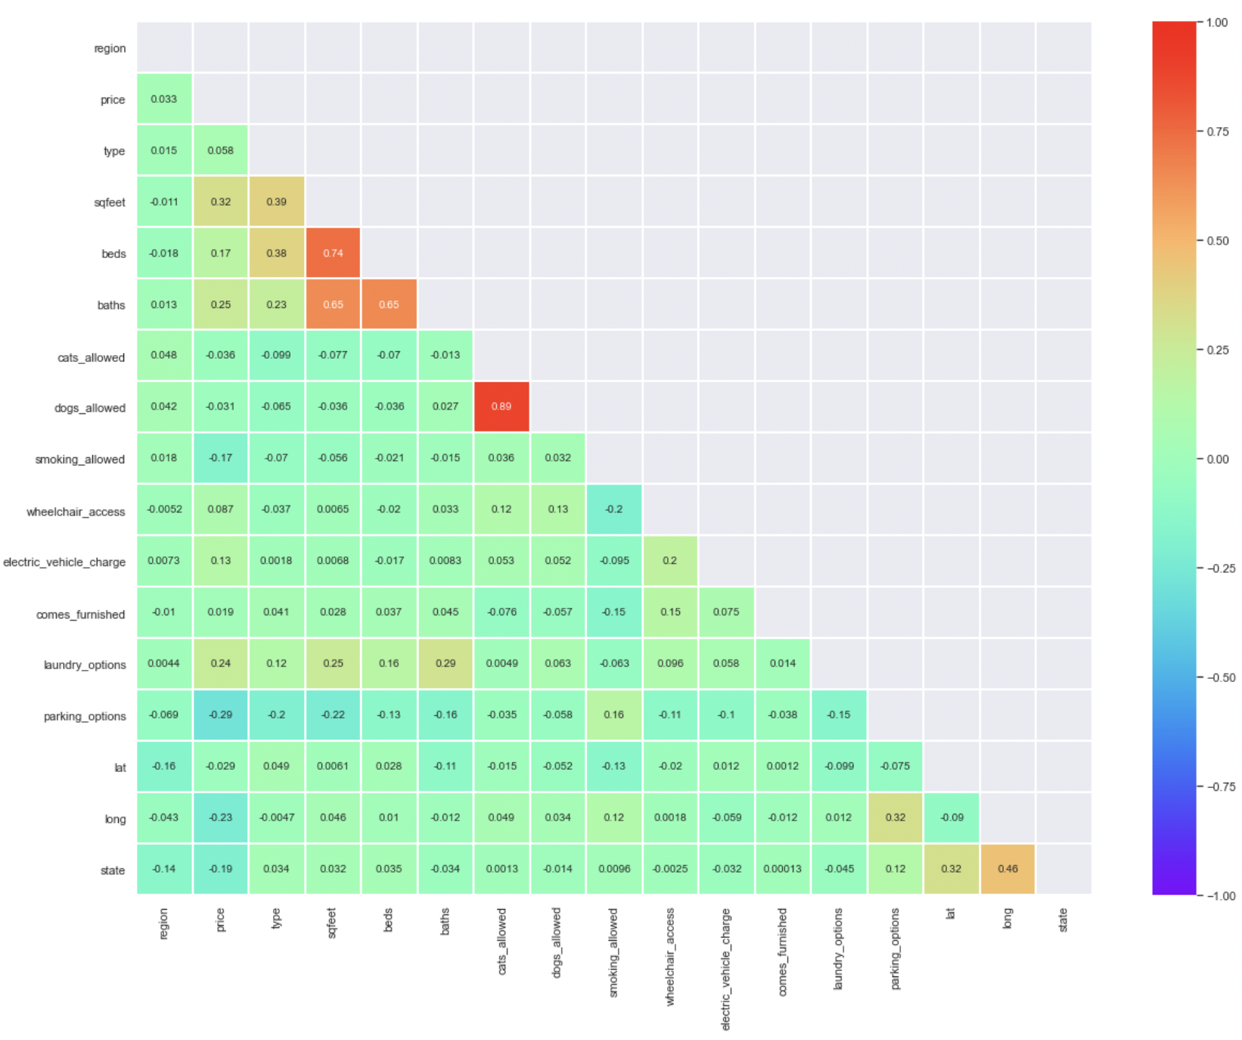
DATa
Visualization

Slide 22
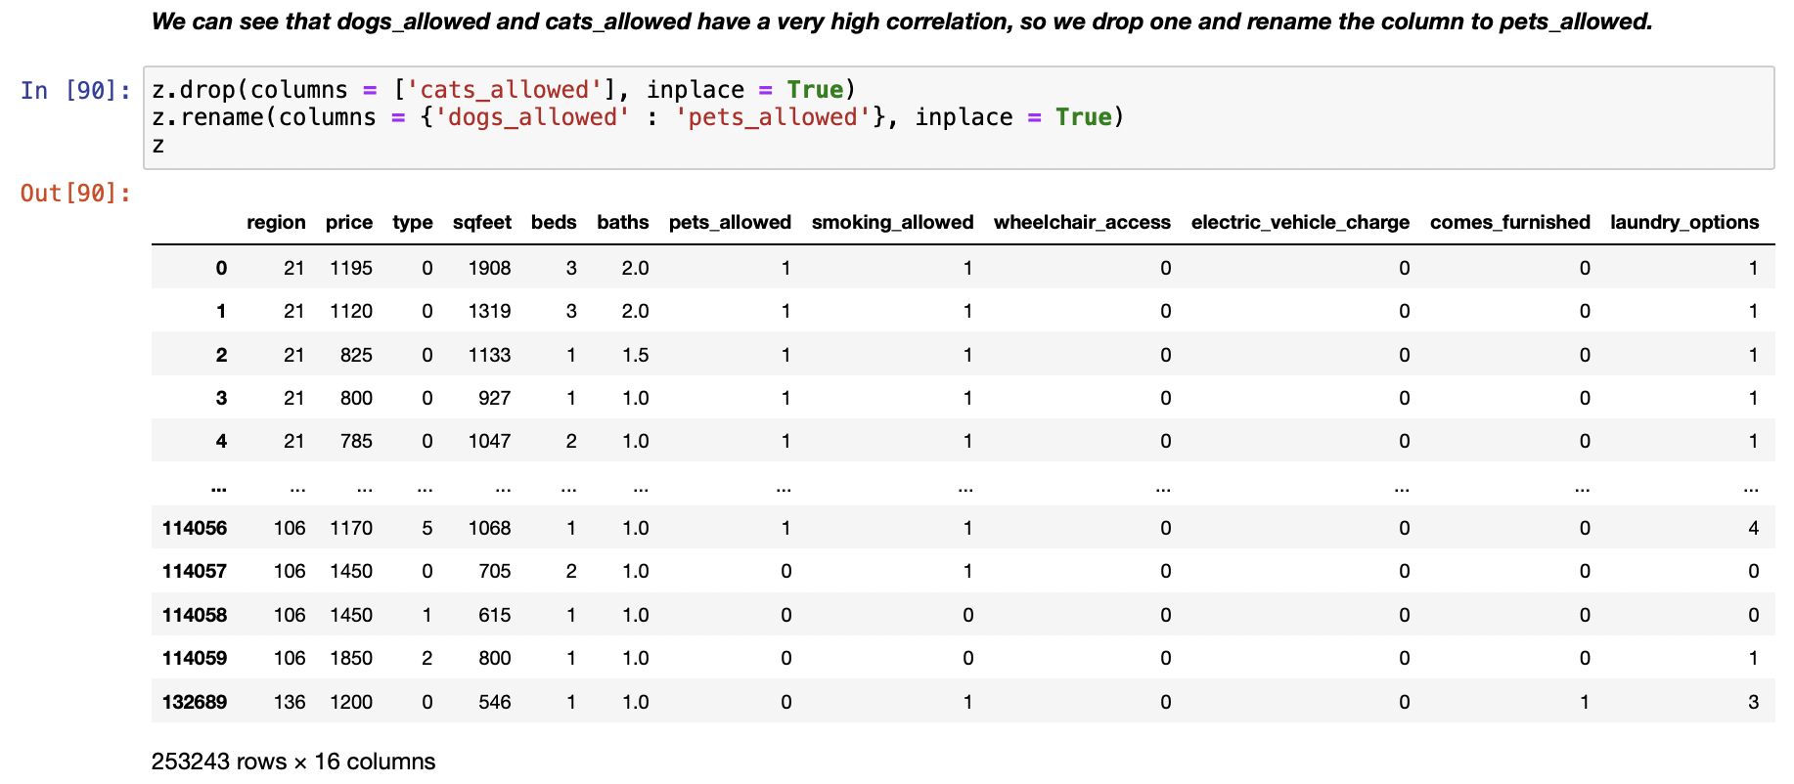
Data Visualization

Slide 23
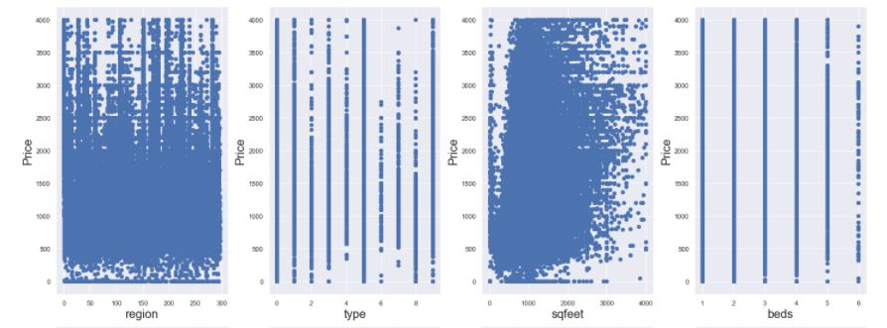
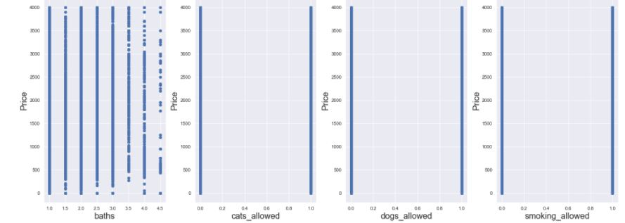
Data Visualization
Target vs Attributes

Slide 24
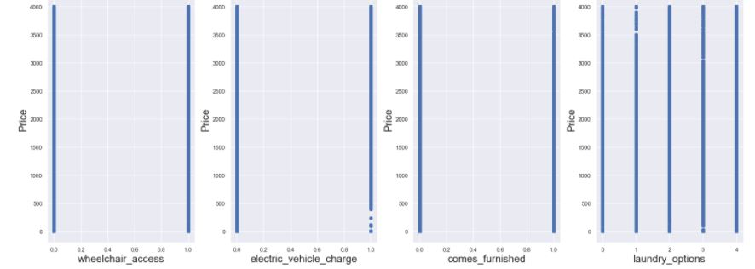
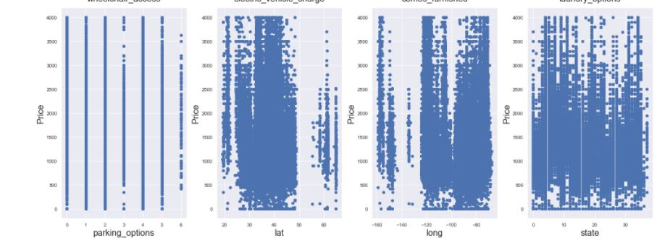
Data Visualization
Target vs Attributes

Slide 25
Models
Linear
Regressor
Decision Tree
Regressor
Random Forest Regressor
K Nearest Neighbors

Slide 26
Predicted Scores
25.64%
80.65%
89%
44.94%
Linear
Regressor
Decision Tree
Regressor
Random Forest
Regressor
K Nearest
Neighbors

Slide 27
Conclusion
We have done all the necessary Data processing and Calculations, of all the Algorithms used Random Forest has the highest accuracy score for Prediction of Rents.

Slide 28
References
A Technical Report on Real Estate Rent prediction: http://mars.gmu.edu/bitstream/handle/1920/11644/rafatirad_realestate.pdf?sequence=1&isAllowed=y
https://towardsdatascience.com/interactive-visualizations-in-jupyter-notebook-3be02ab2b8cd
https://towardsdatascience.com/ai-and-real-state-renting-in-amsterdam-part-1-5fce18238dbc
https://towardsdatascience.com/exploratory-data-analysis-with-pandas-profiling-de3aae2ddff3
https://towardsdatascience.com/overfitting-and-underfitting-in-machine-learning-89738c58f610
https://www.analyticsvidhya.com/blog/2021/01/a-quick-overview-of-regression-algorithms-in-machine-learning/

Slide 29

THANK YOU !

